Slide 1

Understanding & Communicating Risk
A Discussion Guide for __topic__

Slide 2

What is the best way to encourage someone to consider a risk and act to reduce it?
Decades of research exist to help firms, public policy agencies, and other organizations understand how consumers respond to risk information and design more effective communication campaigns.
Unfortunately, it is spread across numerous fields and is difficult to find, integrate, and use.
The goal of this discussion is to use the interdisciplinary Seven I’s framework to discuss how we talk to people about __topic__.

Slide 3
Seven I’s Framework: How Consumers Pragmatically Respond to Risk Information
When we share risk information with people, we know that they can do many things with that information.
Ignore
Interrogate
Inform
Identify
Influence
Implement
Intend
We worry the information will be ignored.
These are the Seven I’s
We hope that the call to action will be implemented.
But it can often feel like a roulette wheel in terms of what actually happens.

Slide 4
What are the Seven I’s?
The Seven I’s | Definition
Ignore | People do not notice or attend to your risk information
Interrogate | People ask questions about your risk information
Inform | People change their beliefs (are informed by) your risk information
Identity | People have a facet of their identity invoked by your risk information
Intention | People form a general or specific plan to act about your risk information
Implement | People follow through on their intention and act on your risk information
Influence | People share with others to encourage them to act on your risk information
How can you use the Seven I’s Framework to understand how people think about the __topic__ and encourage them to implement expert recommendations?

Slide 5
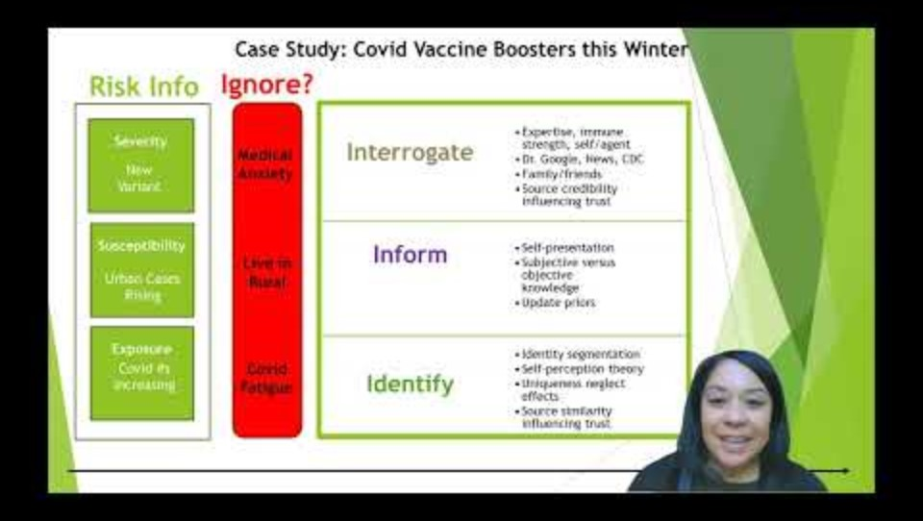
Here is a brief video to explain the Seven I’s Framework
While you watch, consider:
What causes our risk information to be ignored?
Do different people we try to reach have different reasons for ignoring the information?
What are some of the things we hope people will do with our information (i.e., what intentions do we want them to implement?)
Replace with new video link: Dr Maura Scott – Seven I’s Framework

Slide 6
The Basic Seven I’s Framework

Slide 7
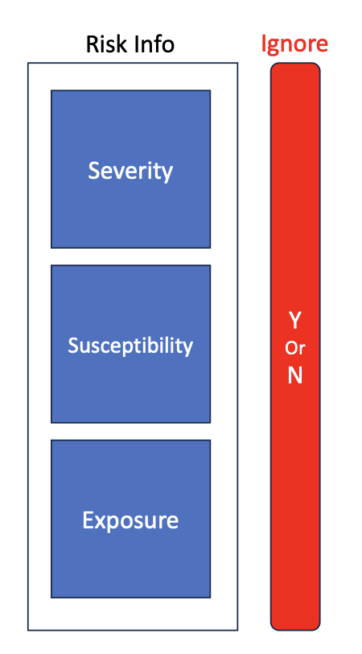
FIRST, risk information has three components that can help jump the IGNORE barrier…
Severity
How serious is the consequence if the risk is realized?
Example: Skin cancer from sun exposure requires serious medical attention and can be fatal in some cases.
Susceptibility
How likely is any particular individual to be harmed by the risk?
Example: Individuals with fair skin or who had early childhood sunburns are most susceptible to sun-based skin cancers.
Exposure
How prevalent is the risk in the community?
Example: Sun exposure is highest for high-altitude locations, in outdoor workforces (like farming or construction), and areas where the ozone layer is damaged.

Slide 8
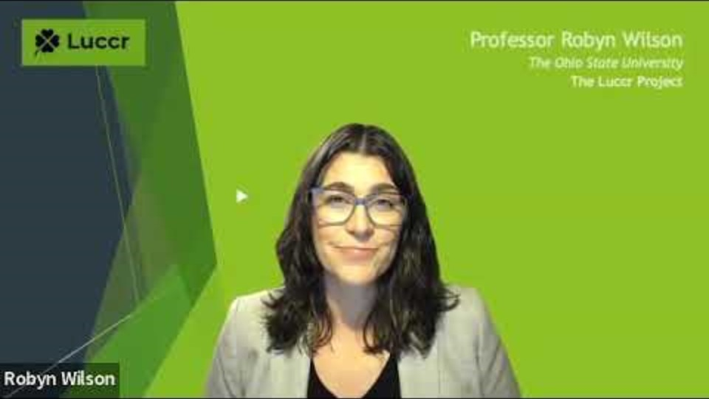
The 3 risk components now for __topic__.
Severity:
Susceptibility: It depends where you live
Exposure:
__severityNotes__
Susceptibility:
__susceptibilityNotes__
__exposureNotes__
Watch this video to think about the three elements of risk.
Which of these can we focus on to make sure people don’t ignore our risk information?

Slide 9
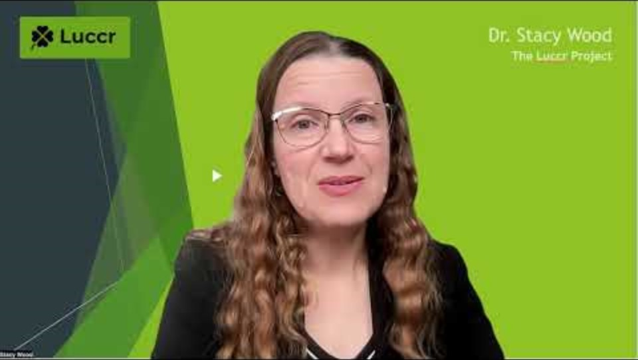
SECOND, consider how people INTERROGATE risk information.
It’s important to expect that people who don’t ignore your message will interrogate it in some way.
Then you can provide ways to help them do that in your message, whether it is by small cues or links to more information
Put video here for Dr. Stacy Wood – why is interrogate…
Here people have issues that they address by considering information from different sources.

Slide 10
Interrogate: __topic__.
ISSUES People Think About
__issues0__
__issues1__
__issues2__
__issues3__
Questions to consider:
Which of the sources do people go to for the different issues?
Sources People Trust for this
__choiceInformation0__
__choiceInformation1__
__choiceInformation2__
__choiceInformation3__
__choiceInformation4__
Do any of these sources provide misinformation?

Slide 11
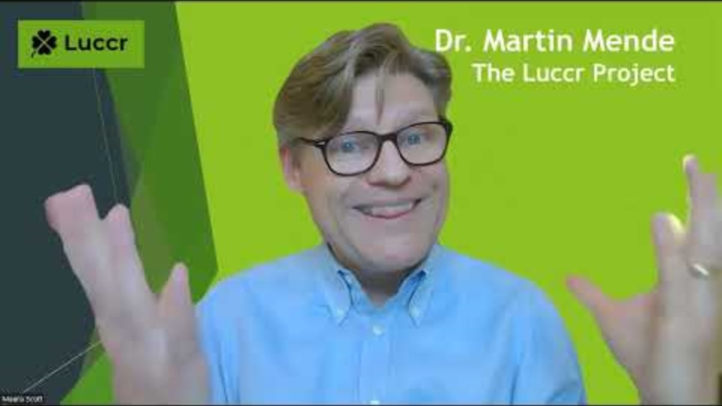
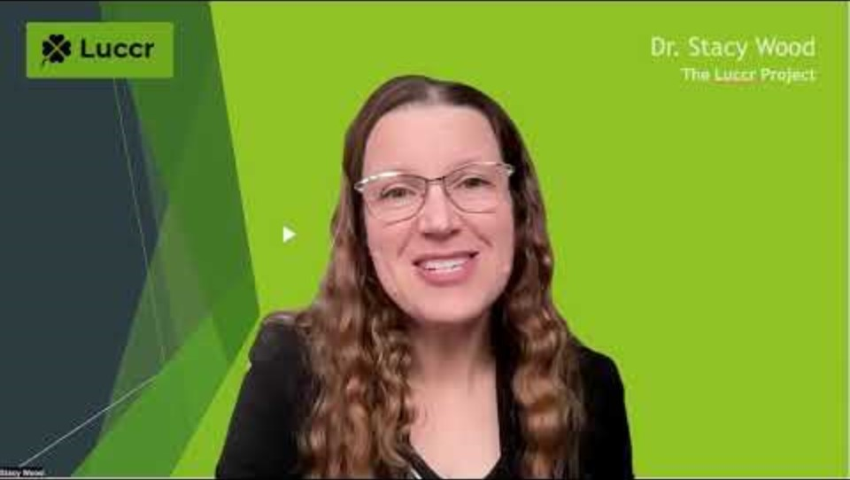
Interrogate
Watch these short videos to hear about each concept
Dr. Martin Mende – source credibility
There are many ways that people question the risk information they receive in order to see if it matters to them.
Here, it’s important to consider the following concepts:
Source credibility
The Elaboration Likelihood Model
Dr. Stacy Wood - ELM

Slide 12
THIRD, we seek to INFORM
Does our risk information actually inform people, i.e. change their prior beliefs?
Do we really need our risk information to inform people or are we only seeking to remind people of what they already know?
If we seek to inform, there are several concepts that we can consider to help facilitate that process
Key Questions for You:
What does my population believe NOW about this risk?
Is it accurate or inaccurate?
What am I asking them to change?

Slide 13
Inform: __topic__.
Objective Knowledge:
Subjective Knowledge:
When people know less than they think they do, our message needs to signal that a new look is needed.
_risk_
_risk1_
To engage deeper learning, we can:
Prompt people to want to seem informed (be an expert)
Encourage people that learning will yield benefits to others
Use emotional appeals to motivate elaboration & memory

Slide 14
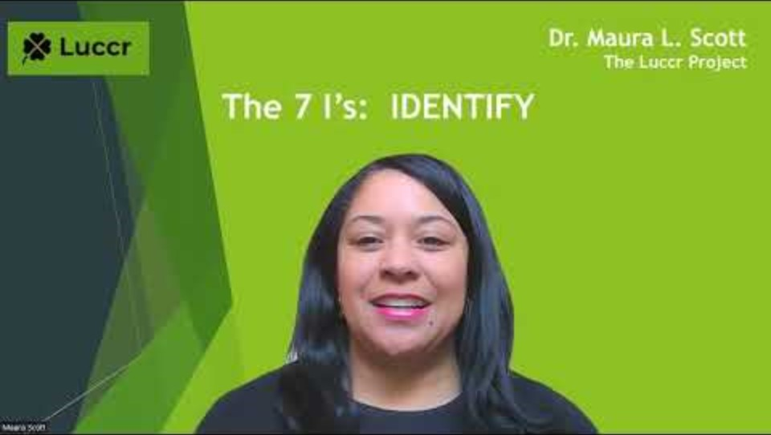
FOURTH, we consider how people IDENTIFY with our risk information
Often messages about risk information triggers different aspects of a person’s identity.
This is especially important when the action we are advocating is public (versus private) or when our population is very diverse.
Here we consider concepts like:
Segmentation
Bem’s Self-Perception Theory
Uniqueness Neglect
Trust & source similarity
Video here for Dr. Maura Scott -- Identity

Slide 15
Identify: __topic__.
Choices about
Choices about
Our population differs in terms of
__topic__ are private actions (not observable to others).
__topic__ do trigger aspects of identity.
Questions to consider:
_population0_
_population1_
_population2_
_population3_
_population4_
_population5_
_population6_
Is there a narrative or logic that supports each identity segment in acting as we advocate?
Can we use a source similar to each of our different segments in our messages?

Slide 16

FINALLY, we hope to move people to action → INTEND, IMPLEMENT, & INFLUENCE
For example, if we were advocating the use of sunblock to mitigate skin cancer risk, we would hope our message recipients would:
Make a plan to buy sunblock
Look at sunblock brands
Buy sunblock
Make a plan to put it on every morning
Keep the sunblock bottle in sight on their bathroom sink
Put on the sunblock
Potentially reapply sunblock
Mention their use of sunblock to others
Advocate or encourage others to use sunblock
Apply sunblock on their children
Remind partners to apply sunblock

Slide 17
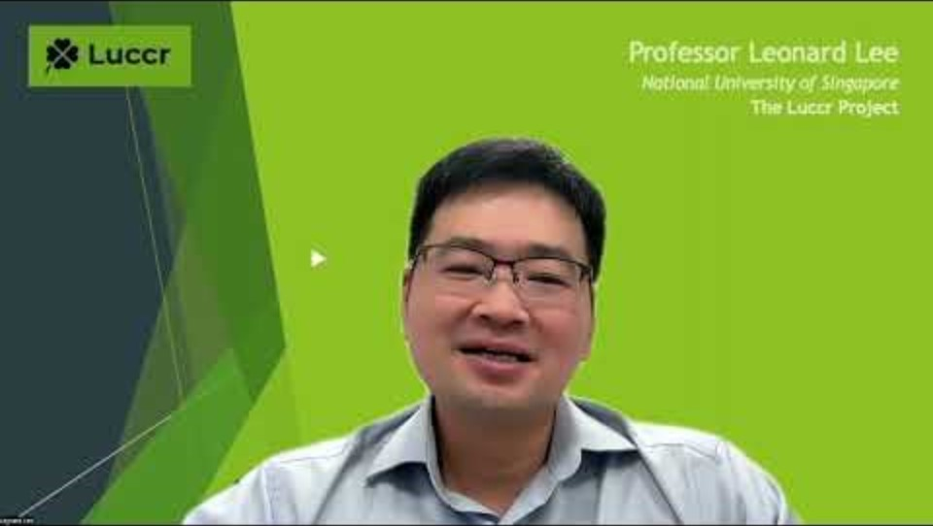
Intend: Best practices to encourage intentions
Create a comprehensive list of all the small actions needed to implement your call to action
Put video here for Dr. Leonard Lee on intentions
Consider whether any of the small actions can be highlighted in your messaging.

Slide 18
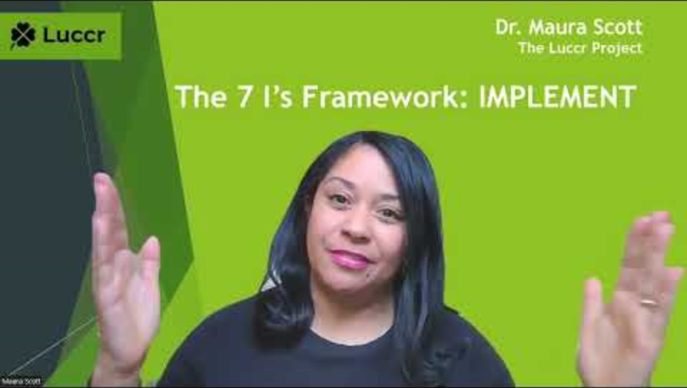
Implement: Best practices to encourage implementation

Slide 19
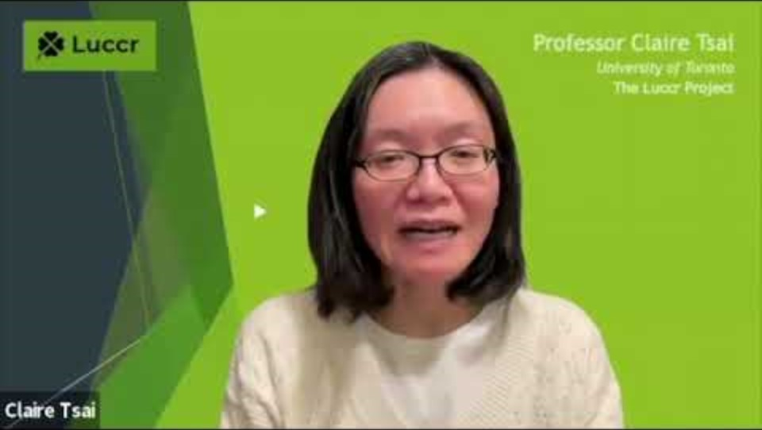
Influence: Best practices to encourage influencing
For your situation, ask:
Is it appropriate for people to talk about this choice and, if so, with who?
Can we prompt or cue that “sharing” behavior in our message?

Slide 20
Putting it all together!
To see a comprehensive framework of the insights you’ve developed, gather your materials from the previous slides and input the material into the Seven I’s Template on the following page.

Slide 21
Putting it all together! Here is the Seven I’s Framework for __________________:
Risk Info
Ignore
Interrogate
Drivers
Behaviors
Inform
Drivers
Behaviors
Identify
Drivers
Behaviors
*INTEND*
Y
Or
N
Implement
Severity
For
Self
Susceptibility
For
Others
Influence
Exposure

Slide 22
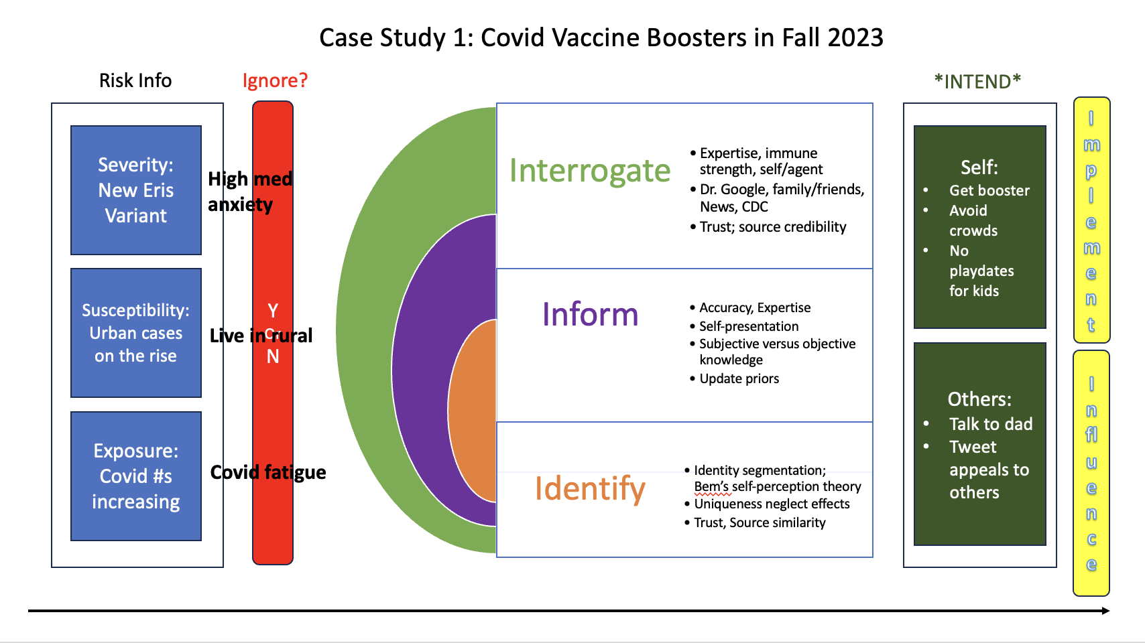
Here is an example of how you can input your information into the framework (then erase this slide from your desk prior to presentation)

